Slide 1
Introduction to Echocardiography: An Overview for the Cardiology Block
William R. Davidson, Jr., MD
Echocardiography
Penn State Hershey HVI

Slide 2
Why watch this slide set (1)?
1. Echo has become such a big part of cardiology practice that it’s best if students get exposure early. Docs in Critical Care, Emergency Medicine and Anesthesia use it, too. Primary care docs order them and use the results.
2. Echo images will be used throughout the cardiology block to illustrate and teach, just as you’ll see coronary angiograms, CT scans, etc.

Slide 3
Why watch this slide set (2)?
3. Sometimes a contracting heart demonstrates more than a pathologic specimen (size, systolic function, flow, etc.)
4. Reading echoes independently requires 6 months out of a 36 month cardiology fellowship for minimum competence.
5. Students can learn the basic views quickly, but mastery takes years.

Slide 4
So……
1. Watch to learn. All those letters and arrows are added for your benefit, readers don’t get such.)
2. YOU WILL NOT BE ASKED TO READ ECHOCARDIOGRAMS INDEPENDENTLY! REALLY. HONEST.
3. No foolin’…..

Slide 5
Notes 1
1. Slides with a ** after the title have text boxes with explanatory narrative.
2. To see text boxes, view in the “Normal” not the “Slideshow” PowerPoint view.
3. In the Slideshow view, images will play automatically and continuously. In the Normal view, each image can be played by hovering over the bottom of the image and clicking the play symbol.
4. Views can be selected from the icons at the bottom right.

Slide 6
Notes 2
5. In the Slideshow view one can halt the video by hovering over and click-dragging the play bar to the desired part of the cardiac cycle. Watch the rhythm strip at the bottom of the slide for timing.
6. It may be useful to move back and forth between the Normal and Slideshow views.
7. Echocardiograms are collected and read in semidarkness. Dim the lights.

Slide 7
Abbreviations
Ao - aorta
LA - left atrium
LV - left ventricle
RA - right atrium
RV – right ventricle
AV, MV, PV and TV – the four valves
US - ultrasound

Slide 8
Echocardiography at HMC**
12 Faculty readers
11 Sonographers, 3 Nurses
4 Exercise Physiologists
>12,000 2D/Doppler studies annually
>2,500 stress echoes annually
>1000 transesophageal studies annually
Interventional echocardiography
Digital Lab
Located in HVI First Floor-stop in and visit
Systems in many remote HVI Cardiology sites
Notes:
In terms of cardiac testing only EKGs are done more frequently than echocardiograms. At HMC 200-250 EKGs are done daily, about 60-70 echocardiograms including stress echoes are done in the adult labs daily. A similar or slightly smaller number are done in pediatric cardiology daily. Each of the other cardiac imaging tests number <10/day.

Slide 9
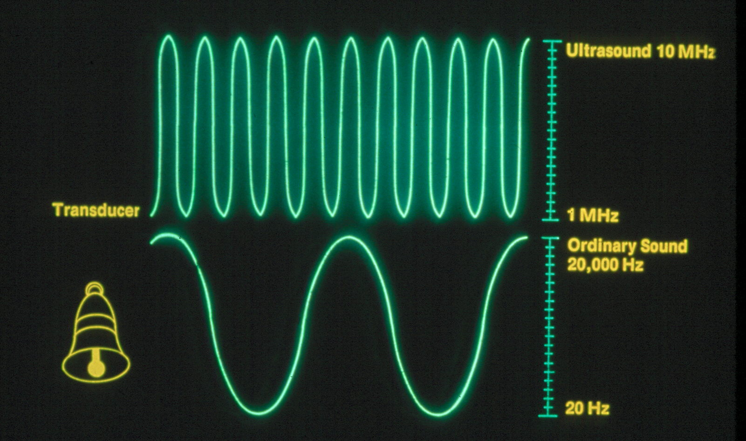
Sound Vs. Ultrasound**
Notes:
Ultrasound (US) is very high frequency sound, typically in Megahertz (MHz) or millions of cycles/s. Audible sound ranges from 20 Hz to 20 Kilohertz (kHz).

Slide 10
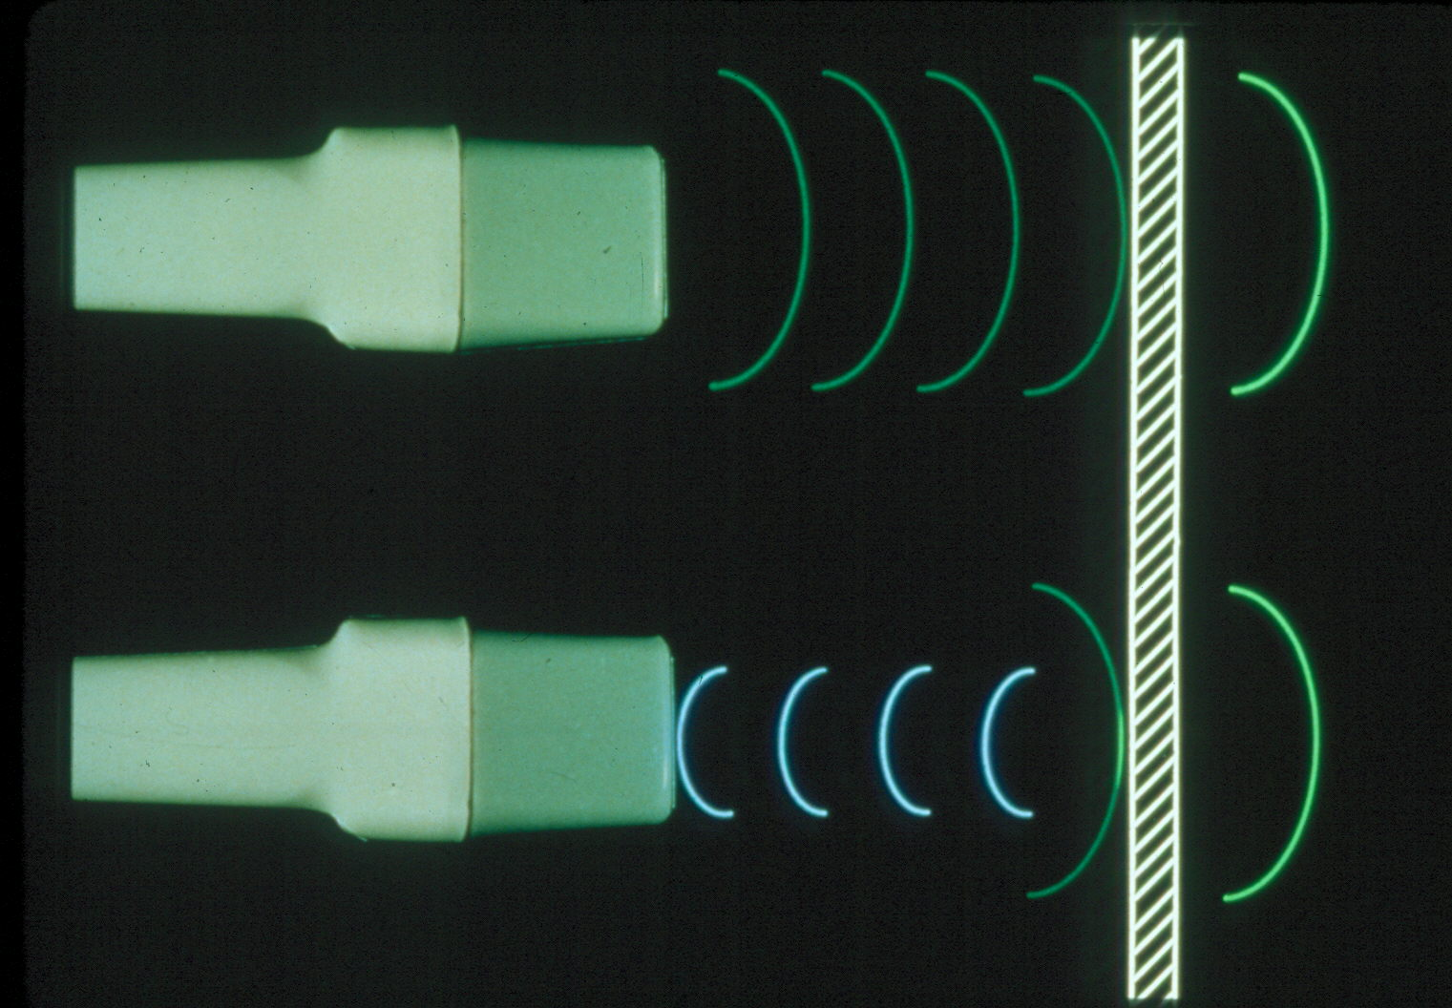
Echocardiography: Ultrasound of the Heart
Notes:
Like SONAR, echocardiography uses reflected ultrasound to create images and track motion

Slide 11
Properties of Clinical Ultrasound**
Reflection – the basis of imaging
Refraction
Absorption
Transmission medium
Velocity (~1,500 m/s in tissue)
Nonionizing (no X-rays, radiation)
Not harmful at imaging intensities
Notes:
Sound is a mechanical wave and requires a medium (unlike light). It is not harmful to humans, and there is no radiation. Energy density is well below what is used in lithotripsy, which causes bruising and shatters stones.

Slide 12
Echocardiography**
Ultrasonic Imaging
Same modality as in –
Abdominal ultrasound
Duplex vascular
scanning
B-mode scanning in
obstetrics
Tomographic Imaging
Similar to –
CT scan (stills)
MRI (20 frames/s)
SPECT radionuclide
imaging (stills)
Higher frame rate than MRI
No radiation, unlike CT and
radionuclide imaging
Notes:
Echocardiography uses ultrasound. like all the imaging modalities on the left. It is also a tomographic technique, so images are a slice through structures, unlike X-rays which are a stack of shadows superimposed. If something is not in the slice, it is not seen.

Slide 13
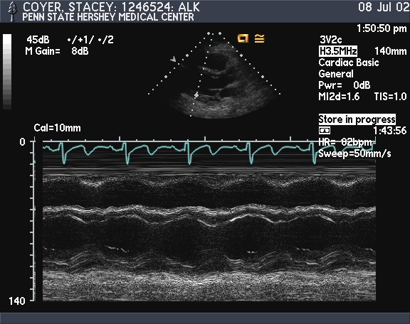
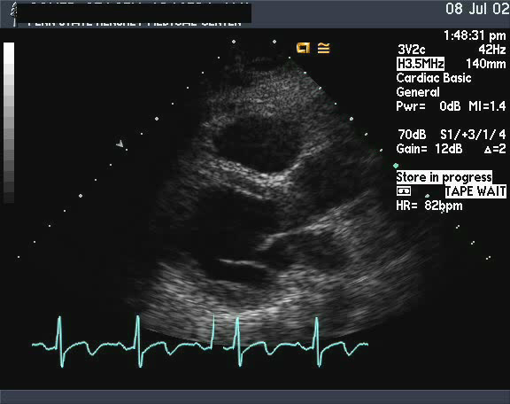
Echocardiography**
2D Imaging
RV
RV
LV
Ao
LV
M-mode
LA
Notes:
M-mode echo depicts motion over time of all structures intercepted by a narrow beam of US. Multiple lines in parallel create a real time 2D sector of up to about an angle of 90° and at 30 or more frames/sec.

Slide 14
Uses of M-Mode and 2D Echocardiography**
Chamber size
Ventricular function
Pericardial effusion
Structural valve abnormalities
Congenital anomalies
Masses and tumors
Coronary artery disease
Notes:
Echocardiography or “echo” has applicability to virtually every class of cardiac disorder as well as noncardiac disorders which affect the heart such as chemotherapy, trauma, etc.

Slide 15
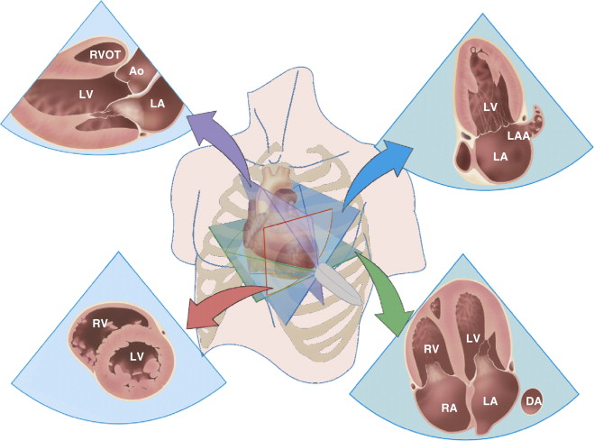
**
Basic image planes used in transthoracic echocardiography. The long-axis view (purple arrow) extends from the LV apex through the aortic valve plane. The short-axis view (red arrow) is perpendicular to the long-axis view resulting in a circular view of the LV. The two-chamber (blue arrows) and four-chamber views (green arrow) are each about 60° rotation from the long-axis view and both are perpendicular to the short-axis view. The four-chamber view includes both ventricles and both atria. The two-chamber view includes the LV and LA.
Normal Anatomy and Flow Patterns on Transthoracic Echocardiography
Otto, Catherine M., MD, Textbook of Clinical Echocardiography, 2, 31-64
Copyright © 2013 Copyright © 2013, 2009, 2004, 2000, 1995 by Saunders, an imprint of Elsevier Inc.
Notes:
Echocardiography uses standardized views taken from left parasternal, apical, subcostal and suprasternal positions. A variety of views can be obtained by rotating the transducer (which emits and receives the ultrasound) in each position such as long- and short-axis parasternal views and 4- and 2-chamber apical views.

Slide 16
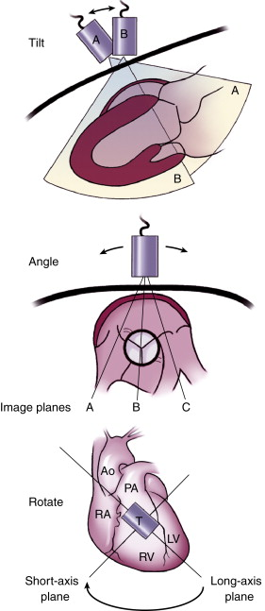
**
Notes:
Transducer motion. This example, using a left parasternal transducer position demonstrates: Tilt : The transducer is “rocked” to provide images (A or B) in the same tomographic plane. Angle : Different image planes (perpendicular to the plane of the figure at lines A, B, and C ) are obtained by angulation of the transducer. Rotation : The transducer is “twisted” with a circular motion to provide a different image plane while maintaining the same orientation between the transducer itself and the chest wall.
Normal Anatomy and Flow Patterns on Transthoracic Echocardiography
Otto, Catherine M., MD, Textbook of Clinical Echocardiography, 2, 31-64
Copyright © 2013 Copyright © 2013, 2009, 2004, 2000, 1995 by Saunders, an imprint of Elsevier Inc.

Slide 17
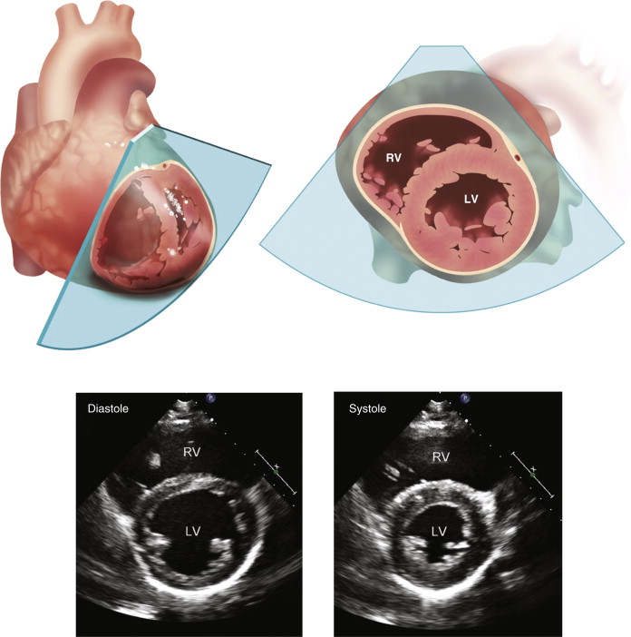
**
Notes:
Short-axis plane at the papillary muscle level. The position of the image plane is shown in the 3D heart, which is opened and rotated to the position corresponding to the echocardiographic image plane. 2D images in diastole and systole in the standard orientation demonstrate the circular shape of the LV with symmetric wall thickening and inward endocardial motion with contraction.
Normal Anatomy and Flow Patterns on Transthoracic Echocardiography
Otto, Catherine M., MD, Textbook of Clinical Echocardiography, 2, 31-64

Slide 18
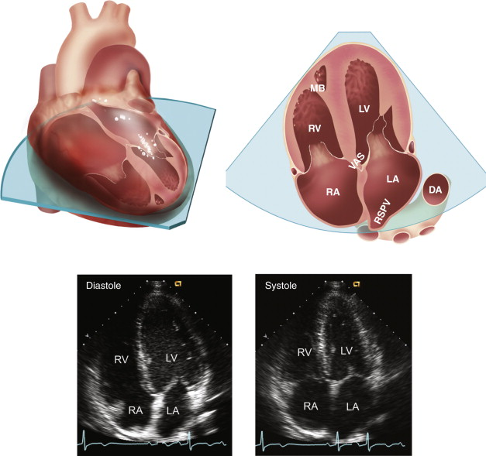
**
Normal Anatomy and Flow Patterns on Transthoracic Echocardiography
Otto, Catherine M., MD, Textbook of Clinical Echocardiography, 2, 31-64
Copyright © 2013 Copyright © 2013, 2009, 2004, 2000, 1995 by Saunders, an imprint of Elsevier Inc.
Notes:
Apical four-chamber view. The four-chamber view is obtained with the transducer on the LV apex, showing the relationships of the left and right ventricles (LV and RV) and atria (LA and RA) in the intact heart (upper left) . The 2D image plane is oriented with the transducer position at the top of the image (upper right). In the LV, the papillary muscle, chordae, and anterior and posterior mitral leaflets are seen. The descending aorta (DA) is seen in partial cross section lateral to the left atrium, while the right superior pulmonary vein (RSPV) drains into the LA adjacent to the interatrial septum. In the right ventricle, the moderator band (MB) and the anterior and septal tricuspid valve leaflets are seen. Note the ventriculoatrial septum (VAS) separating the LV from the right atrium in association with the normal, slightly more apical position of the tricuspid compared with the mitral valve annulus. 2D echo images in an apical four-chamber view at end-diastole and end-systole are shown (bottom).

Slide 19
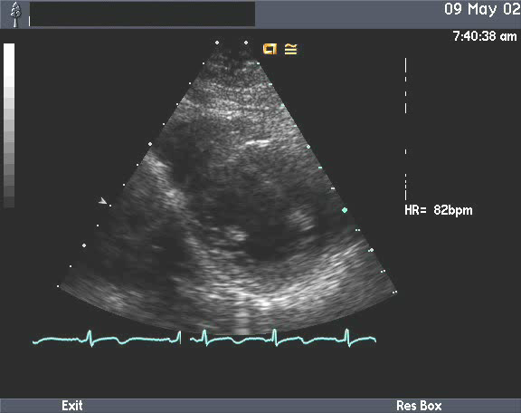
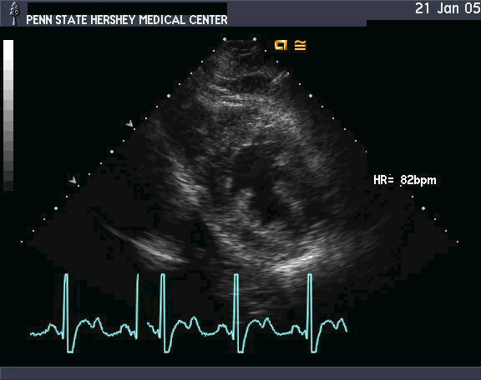
Left Ventricular Pressure Overload**
Concentric LVH
LV
LV
Normal
Notes:
Echo is an excellent tool for assessing ventricular size, function, and hypertrophy. Compared to the image on the left, the right image has more wall thickness and less cavity area for the amount of muscle. This is concentric hypertrophy, the ventricular response to pressure overload as in hypertension and aortic stenosis. The LV looks more like a donut or car tire than a bicycle tire in cross-section.

Slide 20
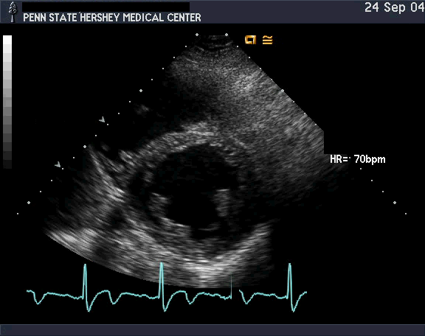
Left Ventricular Volume Overload**
LV dilation or “eccentric” LVH
LV
LV
Normal
Notes:
In LV volume overload such as in aortic regurgitation (AR) or mitral regurgitation (MR), the echo detects a larger LV cavity with wall thickness which is proportionate to cavity size, looking like a bigger bicycle tire. The LV is dilated at end-diastole, and an older term for this is “eccentric hypertrophy”.

Slide 21
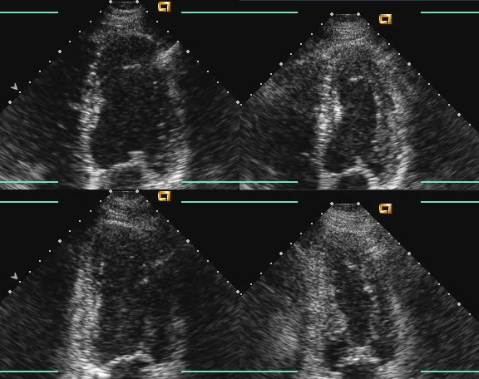
LV Function and Wall Motion Assessment**
4Ch
2Ch
Rest
Post-exercise
Notes:
This is a clip from a normal stress echo. On the left the resting images of the 4 – and 2-chamber views are seen. Immediately after exercise on the right the same views are seen allowing easy side-by-side comparison. The post-exercise images are smaller and uniformly more vigorous. This is a normal LV response to aerobic exercise. No regional wall motion abnormalities appear, so this excludes ischemia.
To see a positive stress echo go to Case 3, the stress test file.

Slide 22
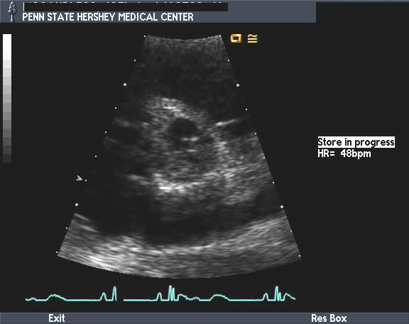
Bicuspid Aortic Valve**
PV
RA
LA
Notes:
Valvular structural abnormalities are easily detected by 2D echo as in this bicuspid aortic valve in the center of this short axis image. The aortic valve closes in a straight line diagonally from 8 to 2 o’clock. When open, the aortic valve orifice is like a fish mouth, not a triangle (normal).

Slide 23
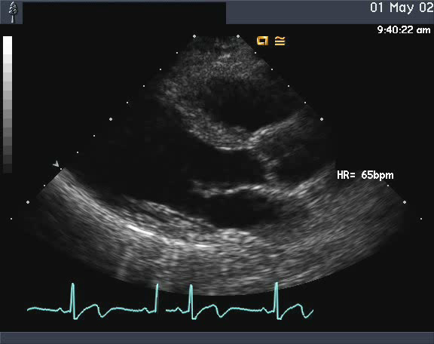
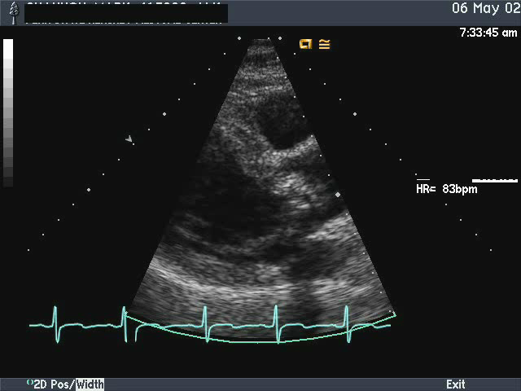
Aortic Stenosis
AV
Normal Aortic
and Mitral Valves
AV
Notes:
Compare the thin, mobile aortic valve on the left with the heavily calcified, poorly opening, ‘doming’ stenotic aortic valve on the right.

Slide 24
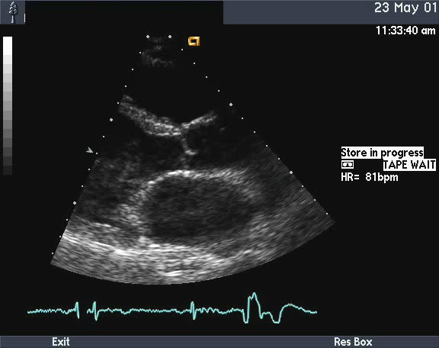
Mitral Valve Prolapse**
LV
LA
Notes:
In mitral valve prolapse one or both mitral valve leaflets prolapse superiorly from their normal closing position beyond the mitral annulus, “sagging” into the left atrium. In this case both leaflets prolapse. Compare to the normal MV on the prior slide.

Slide 25
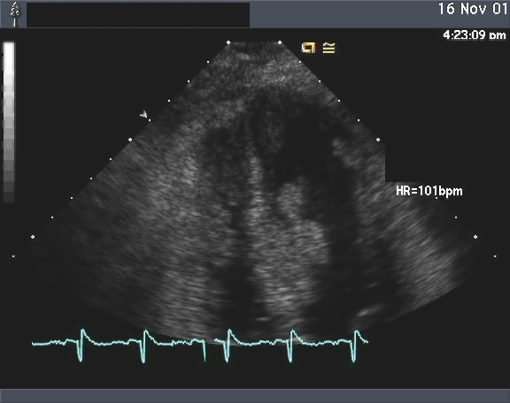
Intracardiac Metastases**
**
****
LV
**
**
RV
Notes:
Echo excels at detecting intracardiac tumors, thrombi and other masses. This unfortunate 43 year old woman had metastatic melanoma masses in all 4 chambers of her heart. Those in the ventricles are attached to the wall, are more mobile than the walls, and are approximately located by the asterisks.

Slide 26
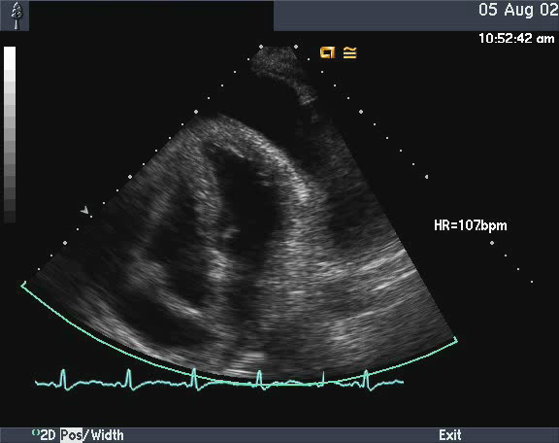
Pericardial Effusion with Tamponade**
PE
RV
RA
PE
Notes:
Echo is the test of choice for detecting pericardial effusions and has specific criteria for identifying the presence of pericardial tamponade or constriction. Here a large pericardial effusion (PE) causes RA systolic collapse and RV diastolic collapse indicating the presence of pericardial tamponade. The left heart chambers are small indicating the severity of increased pericardial pressure.

Slide 27
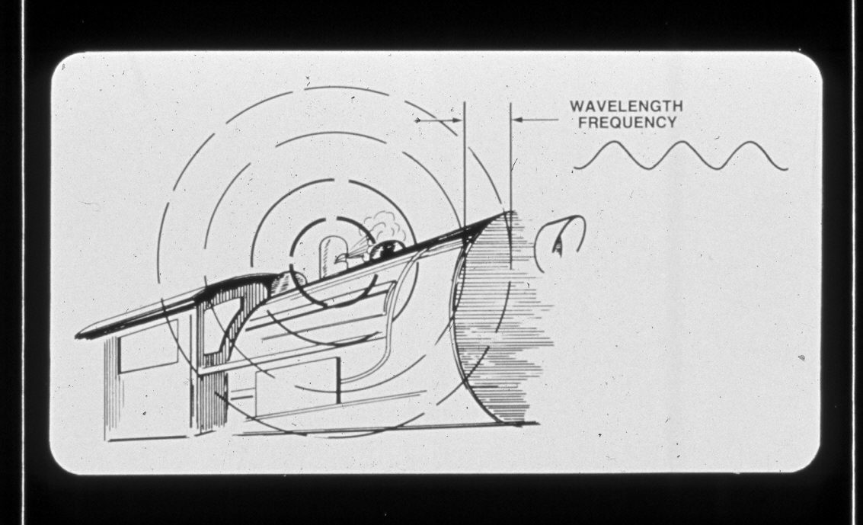
The Doppler Effect**
Notes:
The Doppler effect is the alteration of perceived frequency of sound (or light – think of red-shifted stars) caused by motion between emitter and receiver. Doppler echocardiography uses the Doppler principle and equation to calculate the velocity (speed and direction) of red cells in the blood stream. More recently it has also been used to measure the velocity of cardiac structures such as the myocardium (tissue Doppler).

Slide 28
Doppler Echocardiography
Complementary to 2D imaging
Almost all studies use 2D and Doppler
Provides hemodynamic information:
Valve gradients and areas
Valve insufficiency
Shunt presence and volume
Pressure and flow calculations
Pulmonary pressure
Stroke volumes, cardiac output, shunts
Modalities: Spectral Doppler, Color flow, tissue Doppler, strain imaging

Slide 29
Doppler Equation**
f_{d} = (2f₀ x v x cos θ)/c
v = f_{d} x c/(2f₀ x cos θ)
Cos 0° = 1.00
Cos 20° = 0.94
Cos 45° = 0.71
Cos 90° = 0.00
Doppler sampling
direction
θ
Blood flow direction
Notes:
fd is the Doppler shift. F0 the frequency of US emitted. c is the speed of sound in tissue (1,500 m/s roughly). The angle theta is the angle between the direction of blood flow and the direction of Doppler US interrogation. Cosines of various angles are in the small table. Aligning the US beam with the blood flow direction within 20 degrees allows cosine theta to be ignored when calculating v, the blood velocity.

Slide 30
Bernoulli’s Equation**
Velocity increases related to pressure drop
ΔP mm Hg = 4(v₂² – v₁²) if v in m/s
Simplifies to ΔP = 4(v₂²) when v₁ < 1.0 m/s
Simplified Bernoulli’s Equation: Allows calculation of peak and mean pressure gradients across valves, septal defects, also within stenotic blood vessels.
Notes:
Bernoulli’s equation allows one to calculate pressure drop across valves, other obstructions or leaks non-invasively. This has become a very powerful non-invasive means of assessing intracardiac hemodynamics. Valve gradients, valve areas, PA pressure, cardiac output and more are now calculable by Doppler without performing an invasive cardiac catheterization. Doppler facilitates serial assessment much more frequently than would catheterization. Today, diagnostic catheter hemodynamics are reserved for special, complex cases; when the need to assess pulmonary vascular resistance arises; or when headed to surgery (usually confirmatory when defining coronary anatomy).

Slide 31
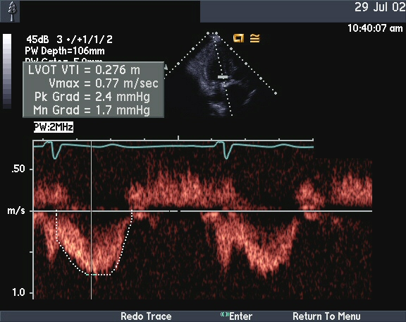
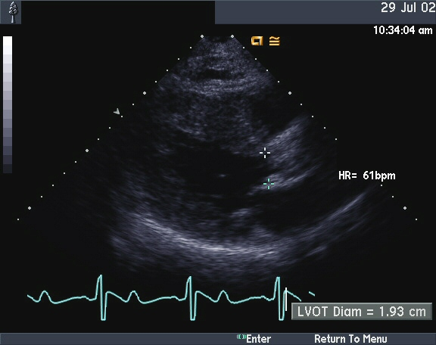
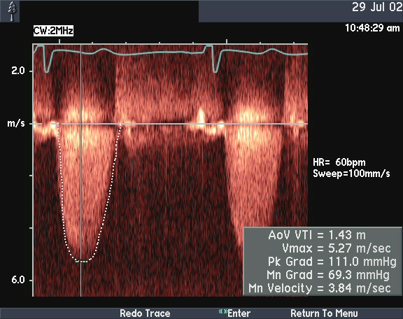
Aortic Stenosis**
LVOT velocity = 0.8 m/s
LVOT D = 2.0 cm
LVOT area x LVOT V =
AV area x AV V
AV mean
gradient =
66 mm Hg
Rearranging:
AV velocity =
5.5 m/s
(3.14 cm² x 0.8 m/s)/5.5 m/s =
0.45 cm²
Normal AVA = 1.9 – 4.0 cm²
Notes:
The continuity equation is used to calculate aortic valve area (see Case 5).

Slide 32
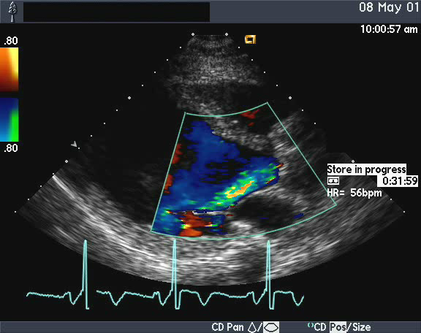
Aortic Insufficiency – Color Doppler**
LV
Ao
AR
LA
Notes:
Color Doppler is a 2D display of blood flow direction and disturbed flow superimposed on 2D images in real time. It is an excellent tool to screen for and quantify regurgitant valve lesions and intracardiac shunts. By convention, red represents flow toward the transducer, and blue represents flow away from the transducer. Disturbed flow has a more multi-color mosaic appearance. In this clip a moderately broad, blue-green jet of aortic regurgitation (AR) pours through the aortic valve into the left ventricle in diastole.

Slide 33
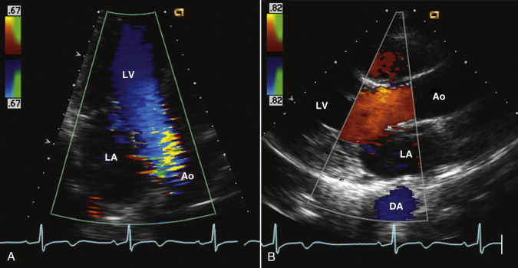
**
Doppler color LV outflow patterns. Flow in the LV outflow tract recorded from an apical approach (A) is blue (away from the transducer), while the same flow from a high parasternal position (B) is red (towards the transducer).
Normal Anatomy and Flow Patterns on Transthoracic Echocardiography
Otto, Catherine M., MD, Textbook of Clinical Echocardiography, 2, 31-64
Copyright © 2013 Copyright © 2013, 2009, 2004, 2000, 1995 by Saunders, an imprint of Elsevier Inc.
Notes:
Understanding color Doppler: Both images show normal motion of blood from LV to aorta in systole. On the left the blood is coded blue as it moves away from an apical transducer position. On the right the blood is coded red as it’s direction of motion (or vector) is more toward than away from a parasternal transducer position. Readers must interpret color Doppler based on transducer position and location within the heart in space and time.

Slide 34
Specialized Echocardiographic Modalities
Transesophageal echo
Intraoperative echo
Intracardiac echocardiography
Stress echo
Exercise stress
Pharmacologic stress (Dobutamine)
Contrast Imaging
Digital echocardiography
3D/4D echo
Tissue Doppler and strain imaging

Slide 35
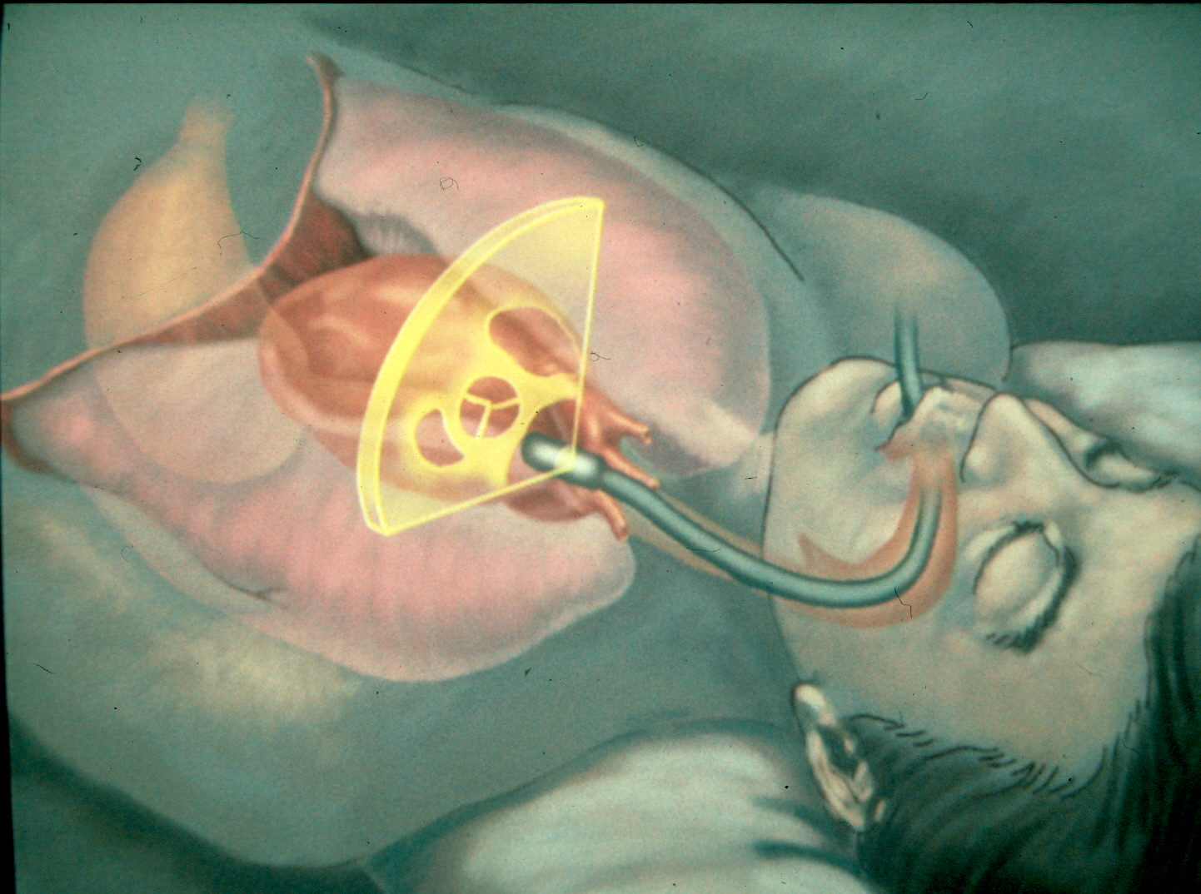
Transesophageal Echo (TEE)**
Useful in:
Cardiac source of emboli
Intraoperative TEE
Interventional TEE
(i.e. ASD closure, TAVR)
Diseases of the aorta
Valve disease
Prosthetic valves
Congenital heart disease
Poor acoustic window
Critically ill/shock
Mechanical circulatory support
Notes:
The US transducer is on the end of a long, endoscope-like probe. It has a multi-planar transducer face which can be rotated through 180 degrees allowing many planes of imaging to be performed. It is passed into the esophagus and stomach with the patient under conscious sedation or in the operating room for CT surgery and can be safely placed in critically ill hypotensive patients in which it will establish a diagnosis and/or change management in 50% of cases.

Slide 36
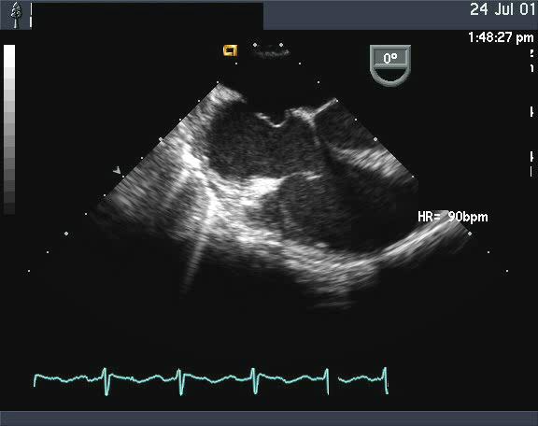
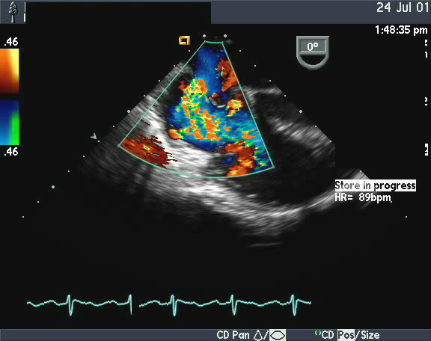
Atrial Septal Defect**
LA
RA
RV
Notes:
TEE detection and quantification of an ostium secundum atrial septal defect. 2D image on the left display the defect in the atrial septum where it can be sized for percutaneous closure. On the right, color Doppler depicts left atrial blood coursing through the ASD into the right atrium, a moderate-sized left-to-right shunt.

Slide 37
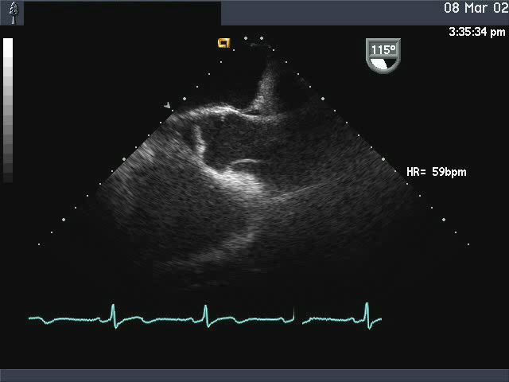
Aortic Dissection**
Back
LA
AV
Ao
Head
Feet
RV
Dissection flap
Chest
Notes:
TEE is the test of choice for characterizing acute aortic dissection in critically ill unstable patients. CT angiography is often used first in more stable patients in the ED. Afterwards TEE is often still needed to assess the extent of the dissection proximally and assess the nature of coronary and aortic valve complications. MRA and CTA are preferable in chronic dissections and its complications.

Slide 38
Stress Echocardiography
Mode of stress
Exercise – 60-65% of tests
Dobutamine – 35-40% of tests
Ischemia detection
Decline in regional wall motion with stress
Infarction – wall motion abnormality at rest
Alternative modality is radionuclide stress imaging
Echo sensitivity 80-85% (nuclear 80-85%)
Echo specificity 85-90% (nuclear 80-85%)
Duration of SE/DSE 30-60 minutes (nuclear 2-6h)
Both methods commonly used, “equivalent”
Stress echo involves no radiation exposure

Slide 39
Echo/Ultrasound Contrast Agents
5-8+ Millions of microbubbles/ml
Pass through capillary bed
Given IV, opacifies left ventricle
Contain a heavy gas
Octafluoropropane
Gives strong first harmonic echo, i.e.:
-Transducer frequency 1.75 MHz
-Received frequency 3.5MHz

Slide 40
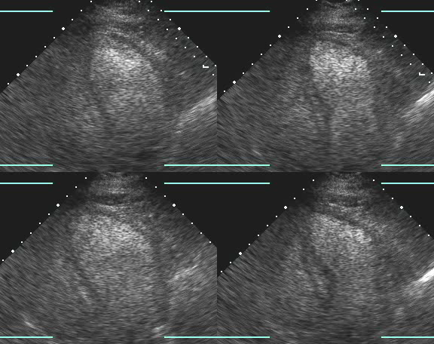
Contrast Enhanced Dobutamine Stress Echo**
Notes:
Normal dobutamine stress echo in a 421 lb. patient who could not walk on the treadmill. Images are enhanced with an ultrasound contrast agent which consists of millions of tiny bubbles having a fragile coat of lipid or protein containing octaflouropropane, a heavy gas which remains in the bubbles. Bubbles are smaller than red blood cells so that when contrast is given intravenously it can be used to opacify the left ventricle using harmonic imaging. This facilitates detection of regional wall motion abnormalities, the hallmark of ischemia and infarction due to coronary artery disease. Images are of the 4-chamber view at rest and through three progressive stages of the test. Read in a ‘Z’ pattern from top left to bottom right.

Slide 41
Digital Echocardiography**
Growth of echo follows growth of PC’s
Now studies handled digitally:
Recording
Measurement and analysis
Report generation
Uploads reports into hospital information system
Image storage and retrieval
Multi-Tb server
Institutional server farm for deep storage
Linked to hospital PACS system, Centricity
Images viewable on any public workstation
Notes:
Digital imaging facilitates access to images from many locations ( a big change from pre-2000 video tape!). It also facilitates reading studies, teaching and research.

Slide 42
Summary**
Echocardiography with Doppler
Useful, safe and highly utilized in virtually all cardiac conditions:
Valve Disease
Coronary disease
Hypertension
Congenital Heart Disease
Cardiomyopathies and heart failure
Arrhythmias
Aortic Disease
Pulmonary heart disease, pulmonary arterial hypertension
Cardiac complications of noncardiac illnesses
Any acutely ill and hemodynamically unstable patient
Guidance in CT surgery, structural interventions
Notes:
Refer back to the normal images for comparison when examining images for cases-based learning.

Slide 43
In case you forgot….
1. These images orient you to a commonly used cardiac imaging technology.
2. Now you will better understand the echo illustrations you see later.
3. Some of these conditions may come up again in this course.
4. You are not expected to learn to read echoes, the concepts should be incorporated into your thinking like everything else you see in the block.
(But the pictures are pretty cool!)

